Slide 1
A small number of abnormal brain connections predicts adult autism spectrum disorder
PRESENT BY LUYAN AND ELLEN

Slide 2
INTRODUCTION
Autism spectrum disorder (ASD) is a major developmental disorder characterized by repetitive, restricted behavior as well as deficits in communication and reciprocal social interactions.
Recently, neuroimaging-based classifiers for ASD and typically developed (TD) individuals were developed to identify the abnormality of functional connections (FCs).

Slide 3
PREVIOUS STUDIES
1. Overfitting:
Determining a large number of model parameters using a relatively small data sample almost inevitably leads to the state of over-fitting, which makes the generalization capability of the model extremely poor.Undesirable fitting to a unique structure of the data, including inherent noise.
2. Nuisance variables (NVs):
NVs include both site-specific conditions in image acquisition and properties in the sample population such as demographic attributes, medication status, and onset and duration of illness. However, the neuroimaging features correlated with these NVs are irrelevant to ASD itself in an independent validation cohort, and naturally for the general ASD population.

Slide 4
DATA
Multiple-site data set in Japan, and confirmed its generalization capability in two independent validation cohorts in the USA and Japan. A total of 74 adults with ASD and 107 age, sex, handedness and IQ-matched TD individuals participated in the present study. The participants were recruited at three different sites in Japan (sites A–C). 44 ASD and 44 TD from the US ABIDE Project.

Slide 5
DATA(CONT.)

Slide 6
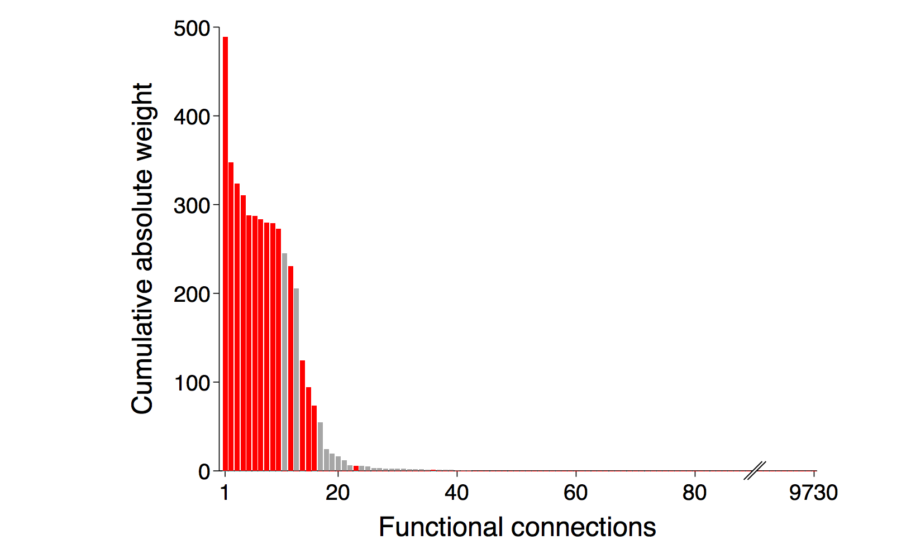
METHOD

Slide 7
METHOD (CONT.)

Slide 8
METHOD (CONT.)

Slide 9
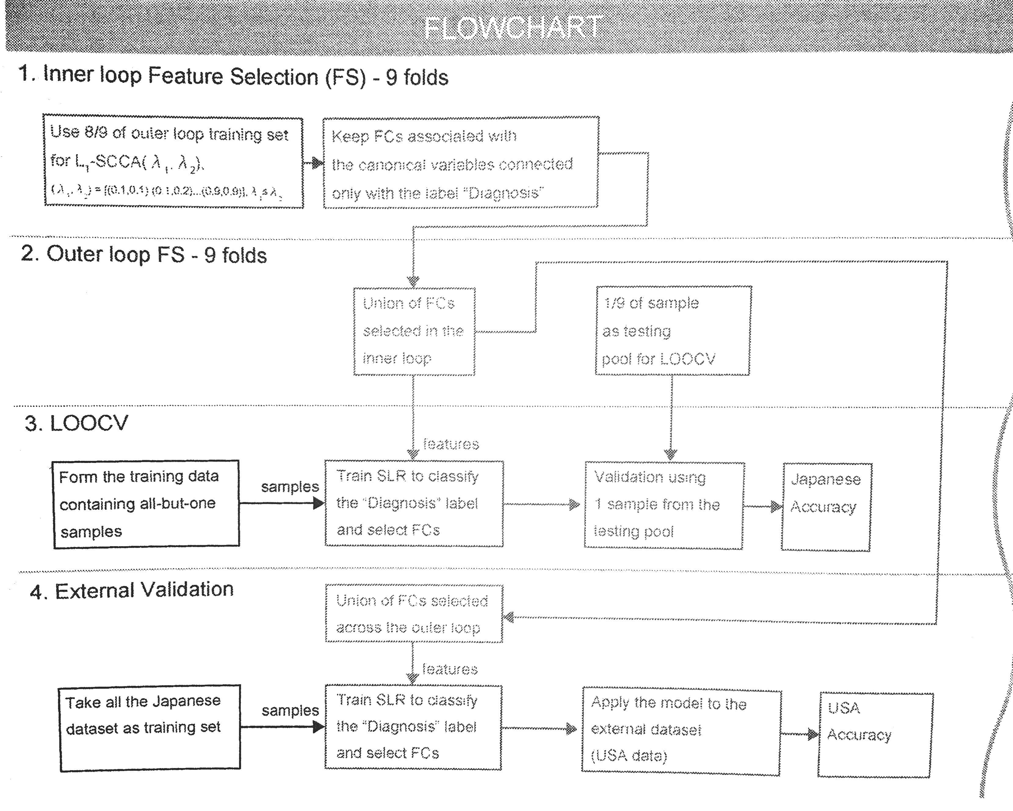
METHOD (CONT.)

Slide 10
METHOD (CONT.): Cross-validation
In each iteration of the inner loop feature selection (FS), 8/9 of the outer loop training set is used to train L1-SCCA with different hyper-parameters. Functional connectivity features (FCs) that are associated with the canonical variables connected only with the label “Diagnosis” are retained.
In the outer loop FS, 1/9 of the samples is retained as testing pool for leave-one-out cross-validation (LOOCV), and the union of the FCs selected throughout the inner loop is derived.
One sample is taken from the testing pool of the outer loop, and used as test set of LOOCV. The remaining samples are used to train SLR on the union of the FCs retained during the inner loop. This procedure is repeated for every sample in the testing pool of the outer loop. In this way, the test set of LOOCV is always independent from the dataset used to select features.

Slide 11
METHOD (CONT.): Classification
The union of the FCs selected across the outer loop is used to train the final SLR on the whole Japanese dataset, and validated using an external cohort dataset (e.g. the US ABIDE dataset). In conclusion, nested feature selection is used to remove nuisance FCs, LOOCV is used to quantify generalizability on the Japanese dataset, and the external validation is used to quantify generalizability on the independent dataset.

Slide 12
Results and conclusion
The classifier separated ASD- from TD-populations with an accuracy of 85%
The corresponding area under the curve (AUC) was 0.93, indicating high discriminatory ability.
The sensitivity was 80% and specificity was 89%. This leads to a high diagnostic odds ratio (DOR) of 31.1, which indicates that the effect size is very large.
For this US-independent validation cohort located across the Pacific from Japan, the present classifier, trained only with Japanese labelled samples, achieved a high performance with an accuracy of 75% (AUC=0.76) and a DOR of 9.0.

Slide 13
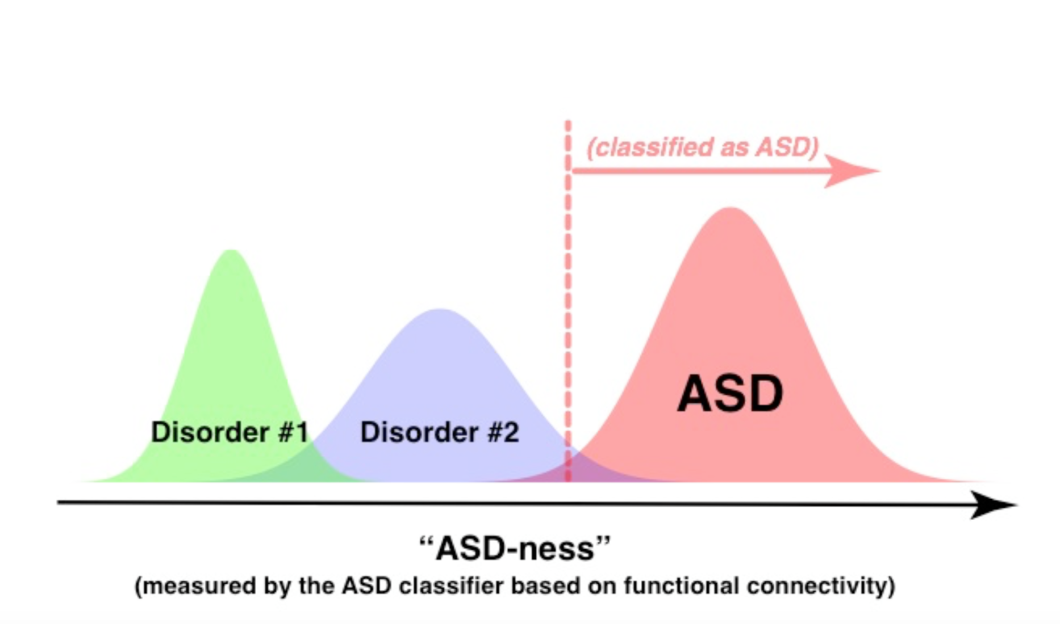
Applications
Applying such a measure to other disorders (such as schizophrenia, attention deficit hyperactivity disorder, major depressive disorder, etc.) may lead to a new possibility of quantifying spectral relationships among them, thereby bridging the categorical and biological dimension views of psychiatric disorders.

Slide 14
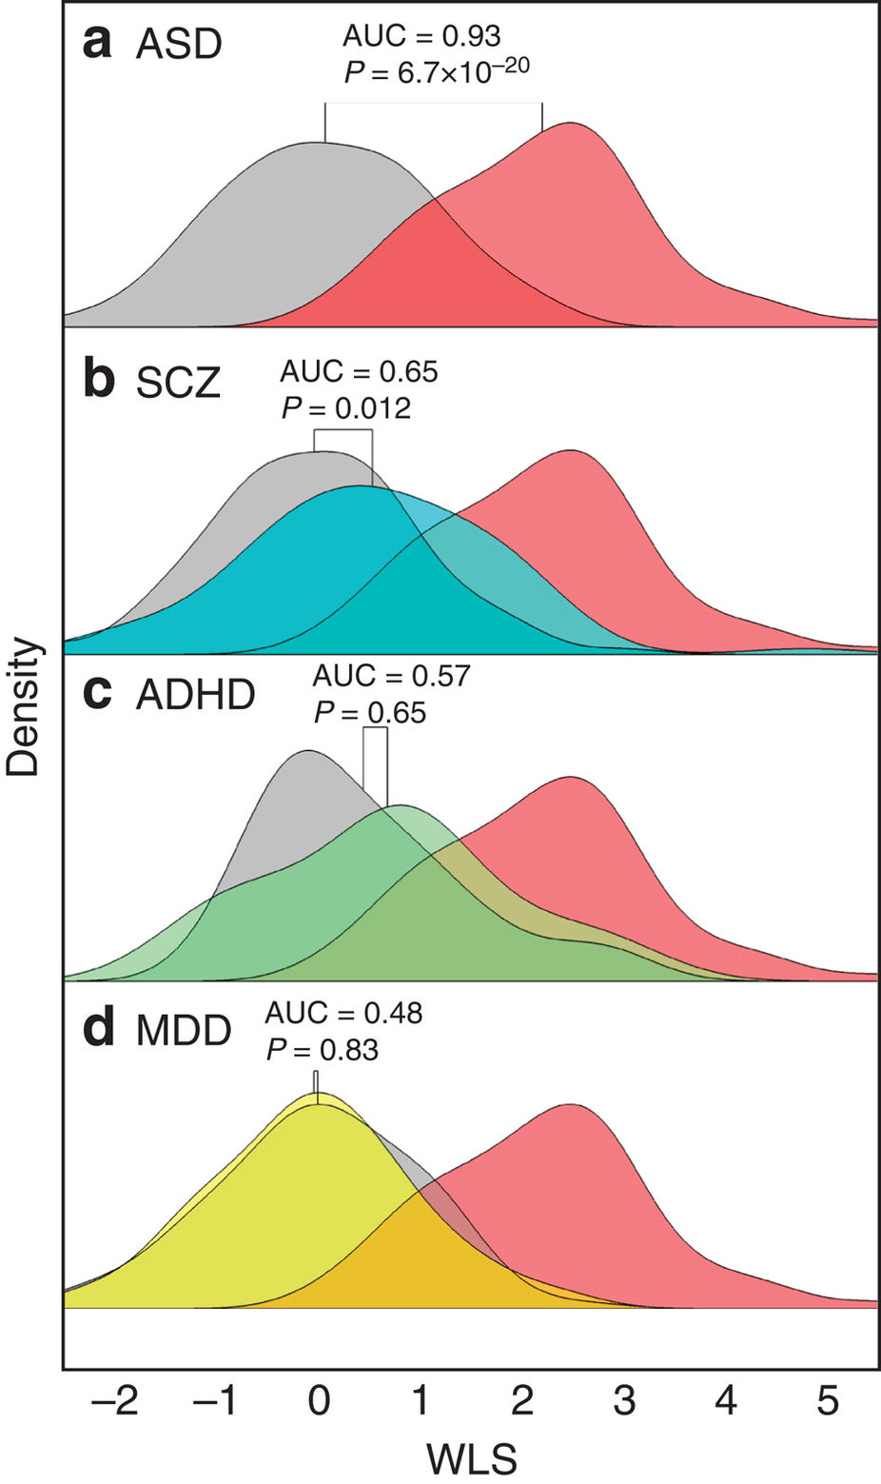
This shows the density distributions of the WLS that resulted from the application of the ASD classifier to data sets for other disorders, SCZ, MDD and ADHD. The results raise the intriguing possibility that the degree of generalizability and specificity of the ASD classifier to these other disorders reflect their spectral structure on the scale of whole-brain intrinsic functional networks.

